Slide 1
Question 4:
The rollercoaster cart is launched to the positive s from the left-most (largest negative s value) stable equilibrium position with a velocity U. There is some value Ucrit > 0 such that for 0 < U < Ucrit the particle either oscillates or goes to −∞ for large times while for U > Ucrit the particle’s position tends to +∞ for large times. Using the energy equation, along with the values of V at the equilibrium positions found in part 2, determine the value of Ucrit.
Using the Leapfrog time stepping code from part 3, compute two numerical solutions for s(t) starting from the left-most stable equilibrium position, one with U slightly less than Ucrit, one with U slightly greater than Ucrit. Is the behaviour as predicted?

Slide 2
All code and pics should be able to be found at:
wormythegreat/Coursework-2

Slide 3
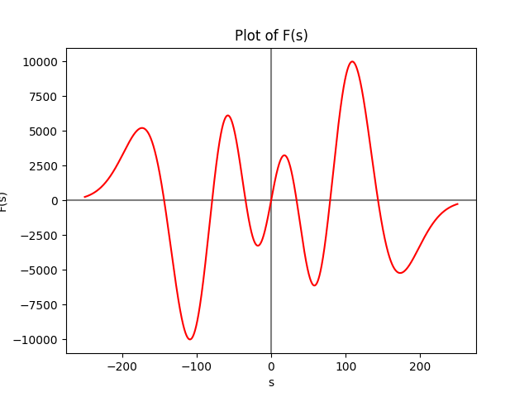
F(s)

Slide 4
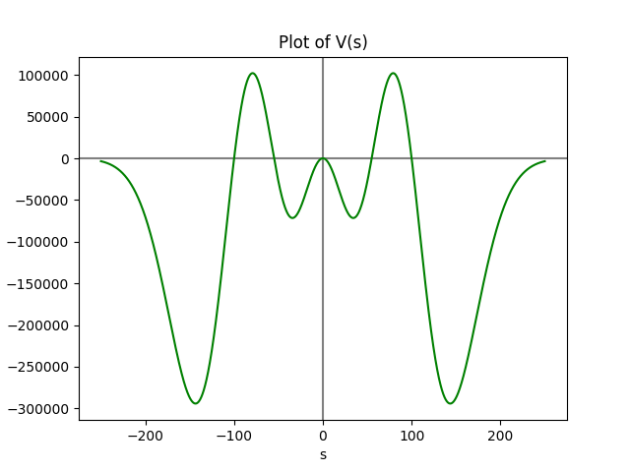
V(s)
eq2
eq1
Coaster launched from here

Slide 5
U_crit
28.1547077266311
U_crit is the speed needed to reach eq2 from eq1

Slide 6
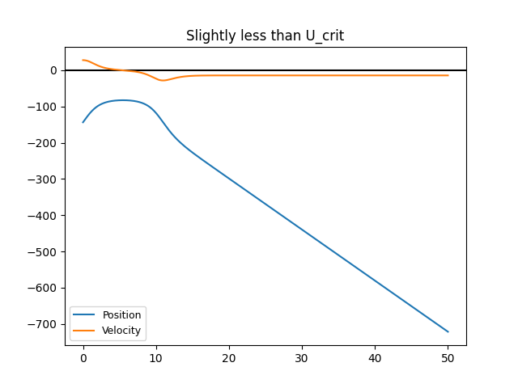
U_crit minus small amount
As expected goes to negative infinity as doesn’t quite reach eq2

Slide 7
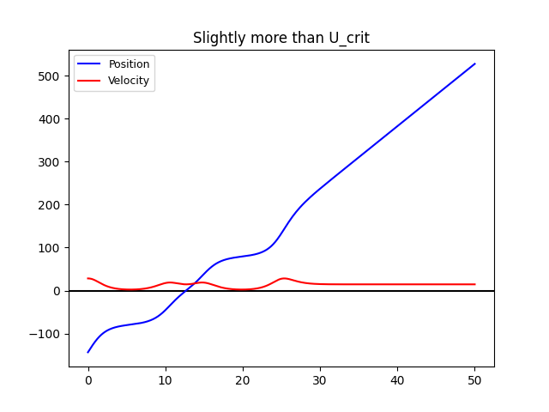
U_crit add small amount
Also as expected goes to plus infinity as goes over eq2

